Slide 1
Instructions for use
This resource aligns to the learning in Stage 2 Year B Unit 36 and revisits content from earlier sample units.
Classroom teachers are encouraged to add, edit and adapt to meet the needs of their students.
Save a copy of the file to make changes to the slide deck. Go to File > Download a Copy (this downloads a copy to the computer to edit in the PowerPoint app).
To convert the PowerPoint to Google Slides:
  Upload the file into Google Drive and open it.
  Go to File > Save as Google Slides.
  (Note – conversion may cause formatting changes in the slides.)

Slide 2
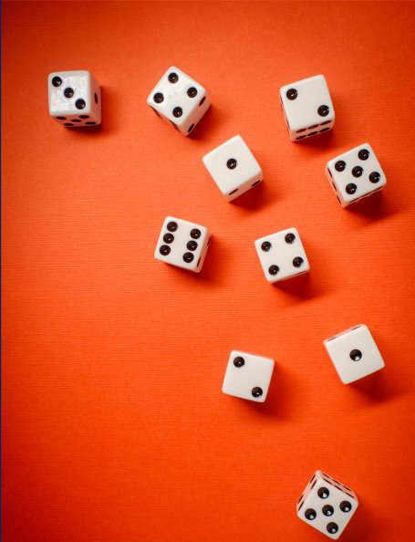
Review of Learning
Mathematics Stage 2 – Unit 36
Notes:
Reviews may include a combination of question types, requiring students to recall facts and key ideas, as well as apply their knowledge to solve problems and answer questions. To support active engagement, a mix of techniques should be employed.” (AERO, 2024).
This Review of Learning slide deck revisits key concepts from the following units:
Stage 2 Year B Unit 36
Stage 2 Year B Unit 35
Stage 2 Year B Unit 34
It also includes opportunities to review prior learning in non-number content, supporting consolidation across focus areas.
The review of learning resources include three key task types that support the development of mathematical proficiency through retrieval, spaced practice, and active participation. These practices complement the review phase (activating prior knowledge) embedded within the beginning of each lesson.
1.
Multiple-choice questions/True or false: Designed to promote active retrieval of key concepts and identify common misconceptions in number, supporting consolidation, understanding and fluency.
These questions:
support spaced and interleaved practice
help identify and address common misconceptions
support active recall and immediate feedback
support whole class participation
identify areas requiring reteach
2.
Short-response question sets: Carefully grouped questions that encourage spaced and interleaved practice across multiple focus areas, helping students revisit and apply knowledge from different points in time.
These questions:
have a combination of question types
address a range of focus areas
build automaticity and fluency
support active recall
allow for immediate feedback
identify content requiring reteach
3.
Developing number sense activities: A variety of practical, purposeful tasks that reinforce current learning and build on prior knowledge. These activities promote reasoning, problem-solving and conceptual understanding.
The review of learning resources are designed to work support teaching and learning in mathematics. For the most effective implementation, use the resources flexibly, adapting to meet student learning needs and individual classroom contexts.

Slide 3
Lessons
1
Review of learning 1
5
Review of learning 5
2
Review of learning 2
6
Review of learning 6
3
Review of learning 3
7
Review of learning 7
4
Review of learning 4
8
Review of learning 8
Notes:
Teacher notes:
Click lesson numbers to go to specific lessons
Interactive features can be viewed in slide show

Slide 4
Review of learning 1

Slide 5

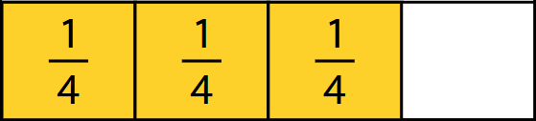
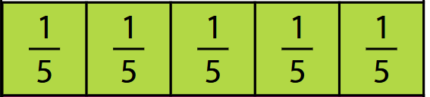
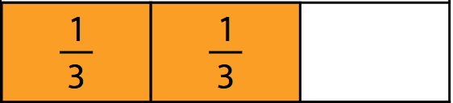
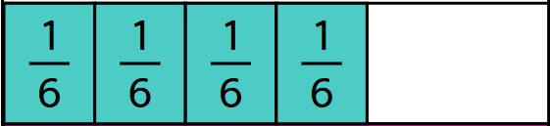
Multiple choice (1) (1) (1)
Which of the following is one whole?
A
C
B
D
Notes:
This question connects to the content in the developing number sense activity (Activity 1)
Syllabus focus area:
Partitioned Fractions B

Slide 6

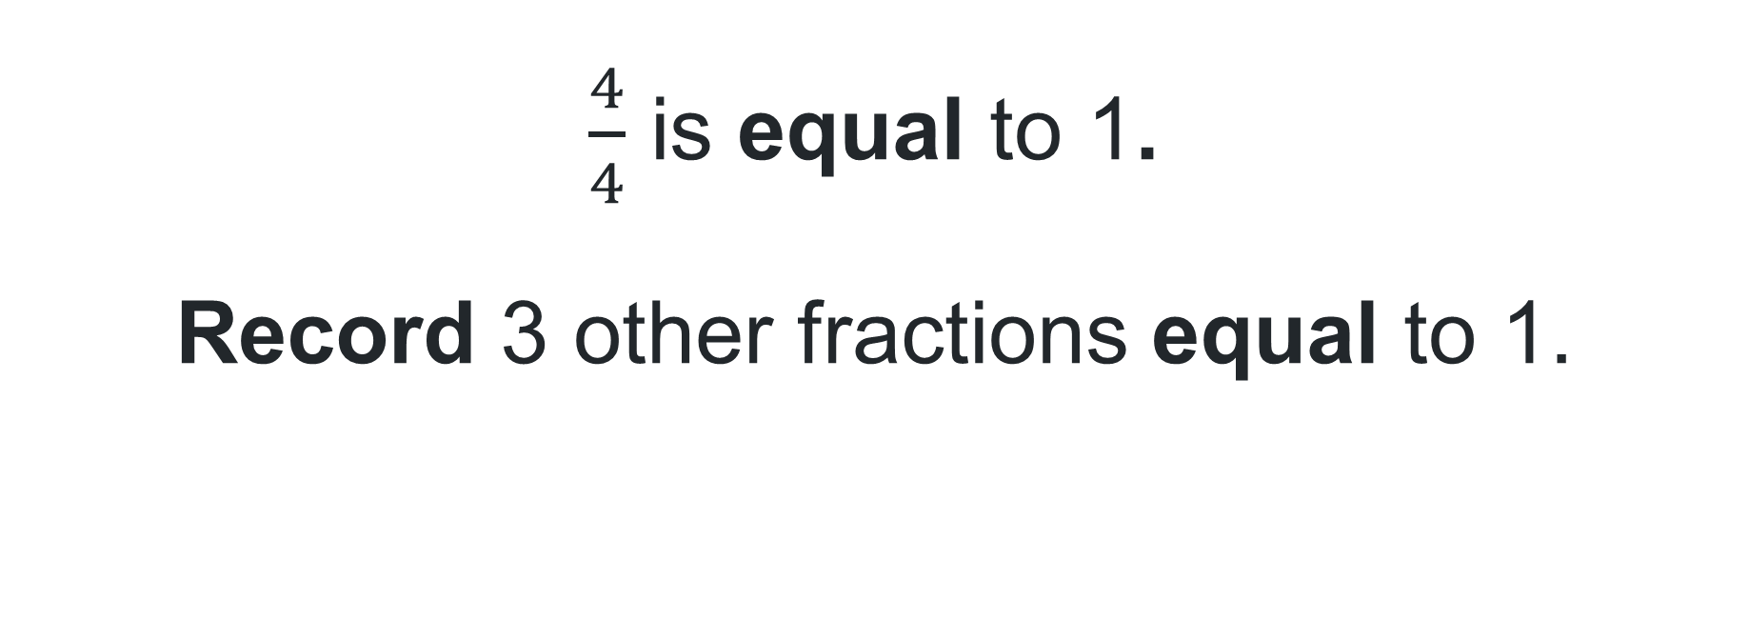
Short response (1)(1) (1)
$\frac{4}{4}$ is equal to 1.
Record 3 other fractions equal to 1.
Notes:
Short response questions provide brisk paced questions focussing on review of current and previous content to support spaced and interleaved practice.
Syllabus focus area:
Partitioned Fractions B

Slide 7

Short response (2)(2))
Alex has 127 cows and 465 sheep on his farm.
How many animals does he have altogether?
Notes:
Short response questions provide brisk paced questions focussing on review of current and previous content to support spaced and interleaved practice.
Syllabus focus area:
Additive relations A

Slide 8
Short response (3)
Julie wanted to build a new, stronger fence around her property so that it could contain her new puppy.
What unit of measurement would she use to measure the fence in?
Notes:
Short response questions provide brisk paced questions focussing on review of current and previous content to support spaced and interleaved practice.
Syllabus focus area:
Geometric measure B: Length

Slide 9
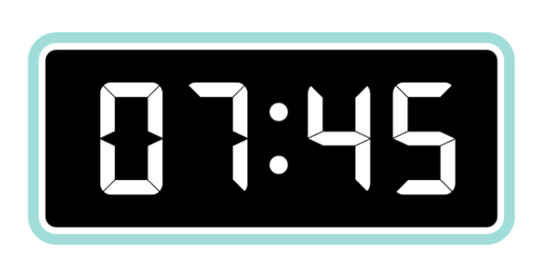
Short response (4)
How much time is left until the next hour?
Notes:
Short response questions provide brisk paced questions focussing on review of current and previous content to support spaced and interleaved practice.
Syllabus focus area:
Non- spatial measure B: Time

Slide 10


Activity 1 – recreating the whole
Interactive fraction strips
Notes:
This is a developing number sense activity.
Number sense refers to a deep understanding of numbers, including their magnitude, relationships, and the effects of operations on them. It supports fluency and understanding, estimation, flexible thinking, and efficient problem-solving. Number sense activities 1–4 ‘activate’ prior number knowledge and support the learning of new content in the unit. Number sense activities 5–8 ‘loop’ back and provide opportunity for spaced practice with concepts and procedures covered in previous units.
Syllabus focus area:
Partitioned Fractions B
Recreating the whole
Display an interactive fraction strips website.
Drag 1 whole into the bottom row and four quarters into the next row of the grid (see Figure 25).
Ask: How can we rename 4/4?
Explain that the length of the yellow bar can be named as 4-quarters or one whole. Label each fractional part with ¼ and record the fraction notation 4/4
In workbooks, students create a bar model showing a whole using thirds, fifths, sixths and tenths, drawing and labelling the missing fractional parts and recording the fractional notation for the whole using the equal sign. For example 1 = 3/3
Select students to show their work samples and explain their thinking to the class.

Slide 11
Review of learning 2

Slide 12
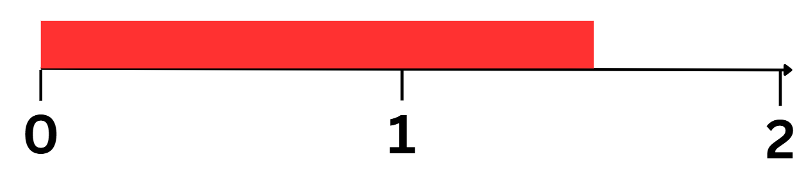
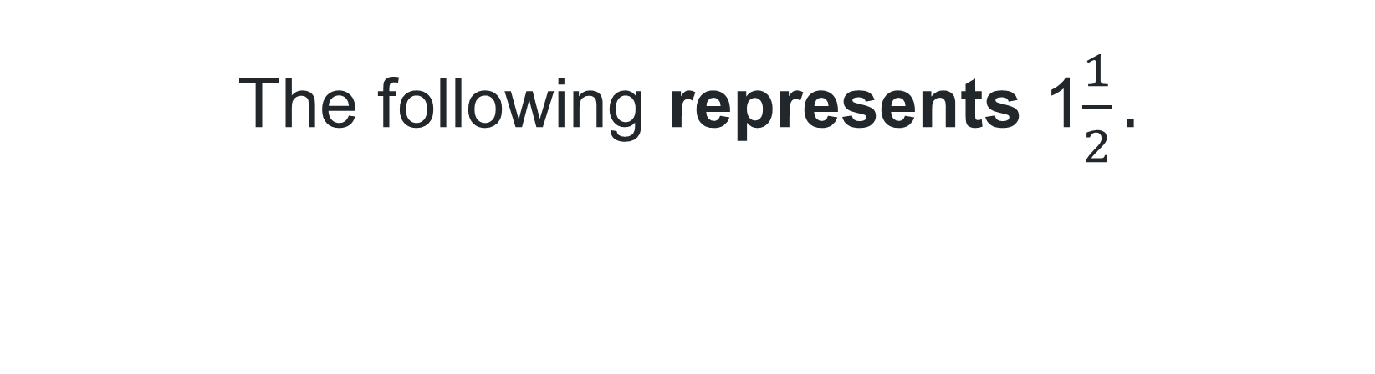
True or false (1) (1)
The following represents 1$\frac{1}{2}.$
True | False
Notes:
The question on this slide connects to the content being explored in the developing number sense activity (Activity 2)
Syllabus focus area:
Partitioned Fractions B

Slide 13
Short response (5)
Use fifths to show a fraction equivalent to one-half.
Notes:
Short response questions provide brisk paced questions focussing on review of current and previous content to support spaced and interleaved practice.
Syllabus focus area:
Partitioned Fractions B

Slide 14
Short response (6)
George had 465 sheep on his farm but during a storm overnight, 167 escaped. How many remain on the farm?
Notes:
Short response questions provide brisk paced questions focussing on review of current and previous content to support spaced and interleaved practice.
Syllabus focus area:
Additive relations A

Slide 15
Short response (8)
Courtenay wanted to see if her new computer could fit on her desk. She measured the length and found it to be 150 centimetres long.
She wants to know how many metres that is.
Can you convert the length of the desk from centimetres to metres?
Notes:
Short response questions provide brisk paced questions focussing on review of current and previous content to support spaced and interleaved practice.
Syllabus focus area:
Geometric measure B: Length

Slide 16
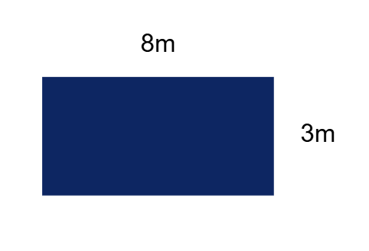
Short response (33)
Draw and label another rectangle with different side lengths with the same area.
Notes:
Short response questions provide brisk paced questions focussing on review of current and previous content to support spaced and interleaved practice.
Syllabus focus area:
Two-dimensional spatial structure B: Area

Slide 17
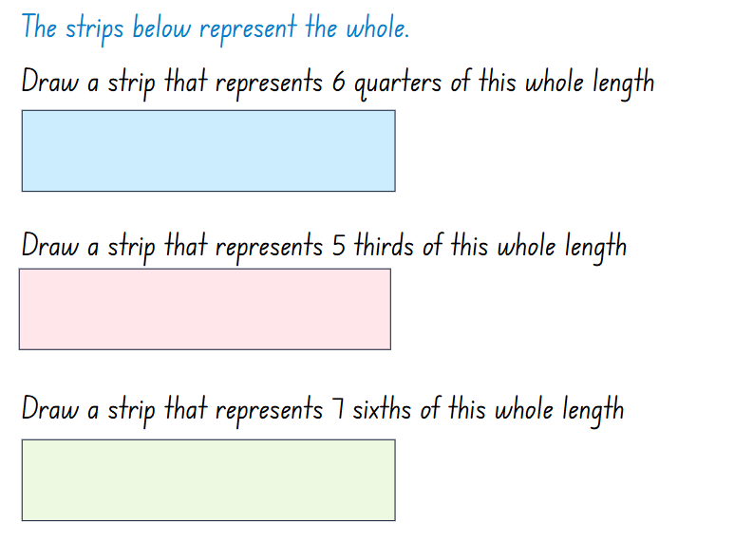
Activity 2 – regroup fractional parts beyond 1
Notes:
This is a developing number sense activity.
Number sense refers to a deep understanding of numbers, including their magnitude, relationships, and the effects of operations on them. It supports fluency and understanding, estimation, flexible thinking, and efficient problem-solving. Number sense activities 1–4 ‘activate’ prior number knowledge and support the learning of new content in the unit. Number sense activities 5–8 ‘loop’ back and provide opportunity for spaced practice with concepts and procedures covered in previous units.
Syllabus focus area:
Partitioned fractions B
Regroup fractional parts beyond 1
Note: fractions can be renamed in multiple ways. For example, 1 $\frac{4}{5}$ can be renamed $\frac{9}{5}$ or $\frac{9}{10}$. In the syllabus, the expression ‘fraction greater than one’ is used instead of the terms ‘improper fraction’ or ‘mixed numeral’.
a rectangular strip on the board and explain that the strip represents a whole length. Ask: How could you create a strip 3-halves the length of the original whole?
Students turn and talk to a partner to discuss how a strip 3-halves the length of the original whole could be created.
Draw a strip the same length as the whole and model partitioning it in half. Draw an additional half-length to represent 3-halves. Record the fractional notation next to the strip as 3/2. Explain that 3-halves can also be renamed as 1 ½.
Provide students with Resource 20 – the whole strip (this resource corresponds to Resource 20 – the whole strip in Stage 2, Year B Unit 36). Students continue the strip by drawing to represent 6-quarters, 5-thirds and 7-sixths the length of the whole. Record the fractional notation next to each strip.
Students regroup and share their work with a peer.

Slide 18
Review of learning 3

Slide 19
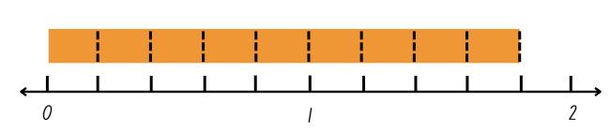
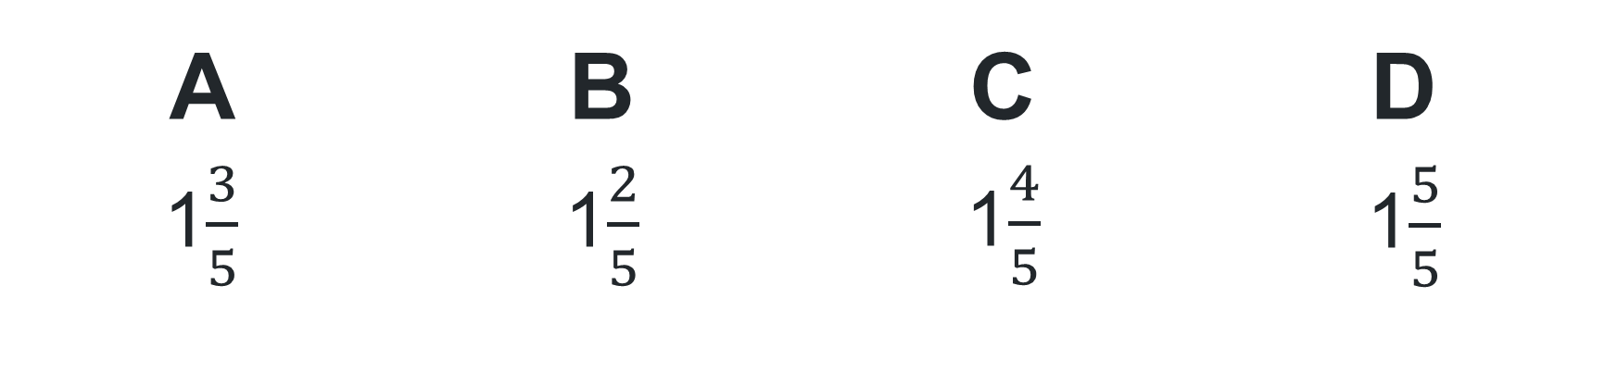
Multiple choice (2) (1)
What is another way to record the fraction
9 fifths?
A | B | C | D
1$\frac{3}{5}$ | 1$\frac{2}{5}$ | 1$\frac{4}{5}$ | 1$\frac{5}{5}$
Notes:
This question connects to the content in the developing number sense activity (Activity 3)
Syllabus focus area:
Partitioned Fractions B

Slide 20
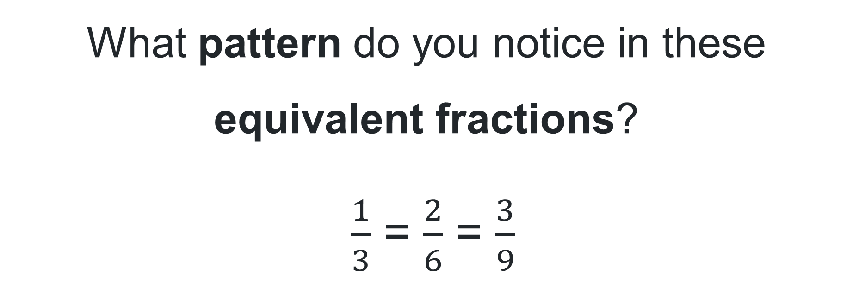
Short response (9)
What pattern do you notice in these equivalent fractions?
$\frac{1}{3}$ = $\frac{2}{6}$ = $\frac{3}{9}$
Notes:
Short response questions provide brisk paced questions focussing on review of current and previous content to support spaced and interleaved practice.
Syllabus focus area:
Partitioned Fractions B

Slide 21
Short response (10)
Emma brought 39 stickers to school. She gave 21 to Bonnie and 11 to Chloe.
How many does she have left?
Discuss the most efficient strategy to solve this problem.
Notes:
Short response questions provide brisk paced questions focussing on review of current and previous content to support spaced and interleaved practice.
Syllabus focus area:
Additive relations A

Slide 22
Short response (11)
Shannon has been asked to build a walking track around a park that is 250 metres long. She wants to know how long the track will be in centimetres so she can order the right amount of materials.
Estimate the length of the track in centimetres?
Notes:
Short response questions provide brisk paced questions focussing on review of current and previous content to support spaced and interleaved practice.
Syllabus focus area:
Geometric measure B: Length

Slide 23
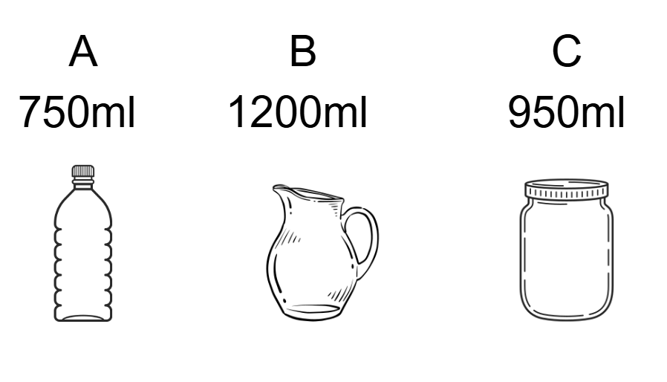
Short response (12)
Order the containers from the smallest to the largest capacity.
Notes:
Short response questions provide brisk paced questions focussing on review of current and previous content to support spaced and interleaved practice.
Syllabus focus area:
Three-dimensional spatial structure B: Volume

Slide 24
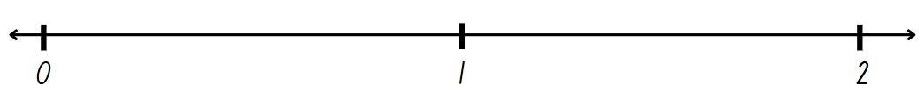
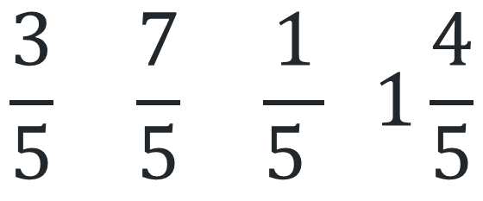
Activity 3 – represent totals of halves, thirds, quarters and fifths that extend beyond 1
$$\frac{3}{5} \frac{7}{5} \frac{1}{5 } 1\frac{4}{5}$$
Notes:
This is a developing number sense activity.
Number sense refers to a deep understanding of numbers, including their magnitude, relationships, and the effects of operations on them. It supports fluency and understanding, estimation, flexible thinking, and efficient problem-solving. Number sense activities 1–4 ‘activate’ prior number knowledge and support the learning of new content in the unit. Number sense activities 5–8 ‘loop’ back and provide opportunity for spaced practice with concepts and procedures covered in previous units.
Syllabus focus area:
Partitioned Fractions B
Represent totals of halves, thirds, quarters and fifths that extend beyond 1
Draw a number line on the board and label it 0–2. Ask: Where would one be placed on this number line?
Students draw a 0–2 number line on their individual whiteboards and label the position of zero, one and 2.
Students partition the number line into fifths and record the following fractions on their number line: 1/5, 3/5, 1 4/5 and 7/5
Write 1 4/5 on the board. Ask: How this fraction could be renamed? 9-fifths. Students record 9/5 on their number line.
Write 7/5 on the board. Ask: What is another way to write this fraction?

Slide 25
Review of learning 4

Slide 26

True or false (2)(1)
2 is the same as 1$\frac{5}{5}.$
True | False
Communicate your reasoning.
Notes:
The question on this slide connects to the content being explored in the developing number sense activity (Activity 4)
Syllabus focus area:
Partitioned Fractions B

Slide 27
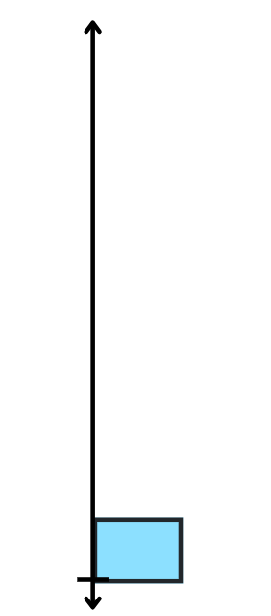
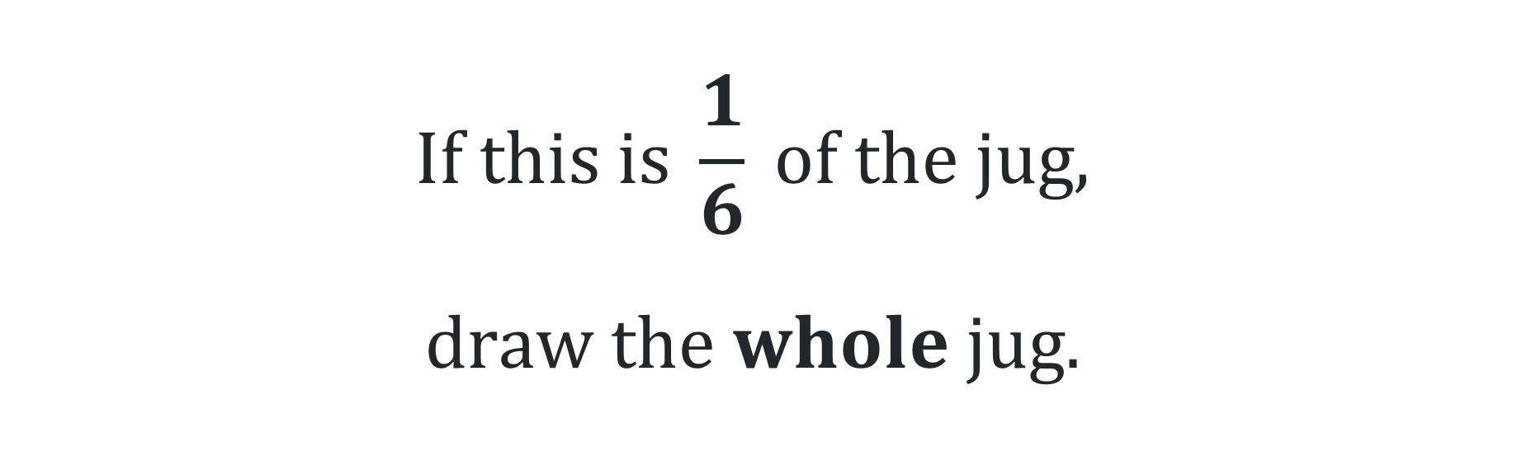
Short response (13)
$$If this is \frac{1}{6} of the jug,$$
$$draw the whole jug.$$
Notes:
Short response questions provide brisk paced questions focussing on review of current and previous content to support spaced and interleaved practice.
Syllabus focus area:
Partitioned Fractions B

Slide 28
Short response (14)
Sarah has 245 marbles, and Ben has 378 marbles. They tipped their marbles into one jar.
How many do they have altogether?
Notes:
Short response questions provide brisk paced questions focussing on review of current and previous content to support spaced and interleaved practice.
Syllabus focus area:
Additive relations B

Slide 29
Short response (15)
Kate wants to build a rectangular flower bed in her backyard. The flower bed will be 4 metres long and 3 metres wide. She needs to calculate the perimeter to figure out how much fencing she needs.
What is the perimeter of the flower bed in centimetres?
Notes:
Short response questions provide brisk paced questions focussing on review of current and previous content to support spaced and interleaved practice.
Syllabus focus area:
Geometric measure B: Length

Slide 30
Short response (16)
What is a tessellating design?
Demonstrate your thinking by drawing a tessellating design using triangles.
Notes:
Short response questions provide brisk paced questions focussing on review of current and previous content to support spaced and interleaved practice.
Syllabus focus area:
Two-dimensional spatial structure B: 2DS Shapes

Slide 31
Activity 4 – renaming fractions
Notes:
This is a developing number sense activity.
Number sense refers to a deep understanding of numbers, including their magnitude, relationships, and the effects of operations on them. It supports fluency and understanding, estimation, flexible thinking, and efficient problem-solving. Number sense activities 1–4 ‘activate’ prior number knowledge and support the learning of new content in the unit. Number sense activities 5–8 ‘loop’ back and provide opportunity for spaced practice with concepts and procedures covered in previous units.
Syllabus focus area:
Partitioned fractions B
Renaming fractions
Students draw a 0–2 number line on their individual whiteboards and label the position of zero, one and 2.
Students partition the number line into thirds and record the following fractions on their number line 2/3, 3/3 and 5/3
Write 2 on the board. Ask: How could this number be renamed as thirds? (6-thirds) Students record 6/3 on their number line.
Ask: How can 5/3 be renamed? 1 2/3
Ask: How can 3/3 be renamed? (one whole)

Slide 32
Review of learning 5

Slide 33
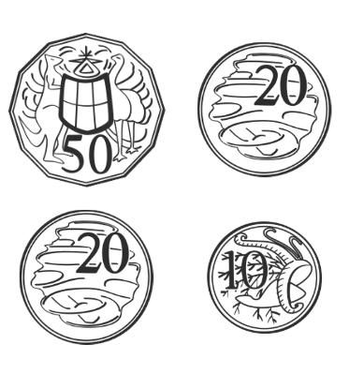
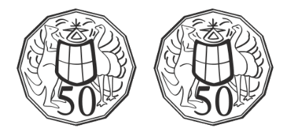
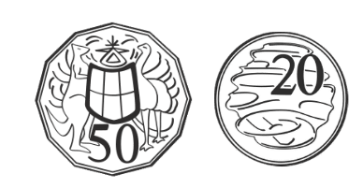

Multiple choice (3)(1)
Which collection of coins is not equivalent to $1?
A | B | C | D
Notes:
This question connects to the content in the developing number sense activity (Activity 5)
Syllabus focus area:
Additive relations A

Slide 34
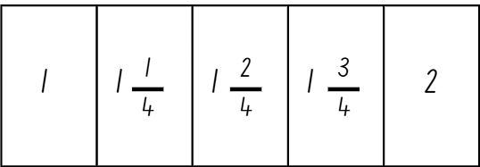
Short response (17)
Describe the pattern.
Notes:
Short response questions provide brisk paced questions focussing on review of current and previous content to support spaced and interleaved practice.
Syllabus focus area:
Multiplicative relations B

Slide 35
Short response (18)
At the school fair there were 1500 balloons.
After the first hour, 625 balloons popped.
How many balloons were still left at the fair?
Notes:
Short response questions provide brisk paced questions focussing on review of current and previous content to support spaced and interleaved practice.
Syllabus focus area:
Additive relations B

Slide 36
Short response (19)
Name 4 objects that are about 1kg.
Notes:
Short response questions provide brisk paced questions focussing on review of current and previous content to support spaced and interleaved practice.
Syllabus focus area:
Non spatial measure B: Mass

Slide 37
Short response (20)
Describe each event using the terms equally likely, likely, or unlikely:
Rolling a six on a standard dice
It raining tomorrow (when the forecast says it's sunny)
Drawing a red card from a standard deck of cards
Notes:
Short response questions provide brisk paced questions focussing on review of current and previous content to support spaced and interleaved practice.
Syllabus focus area:
Chance B

Slide 38
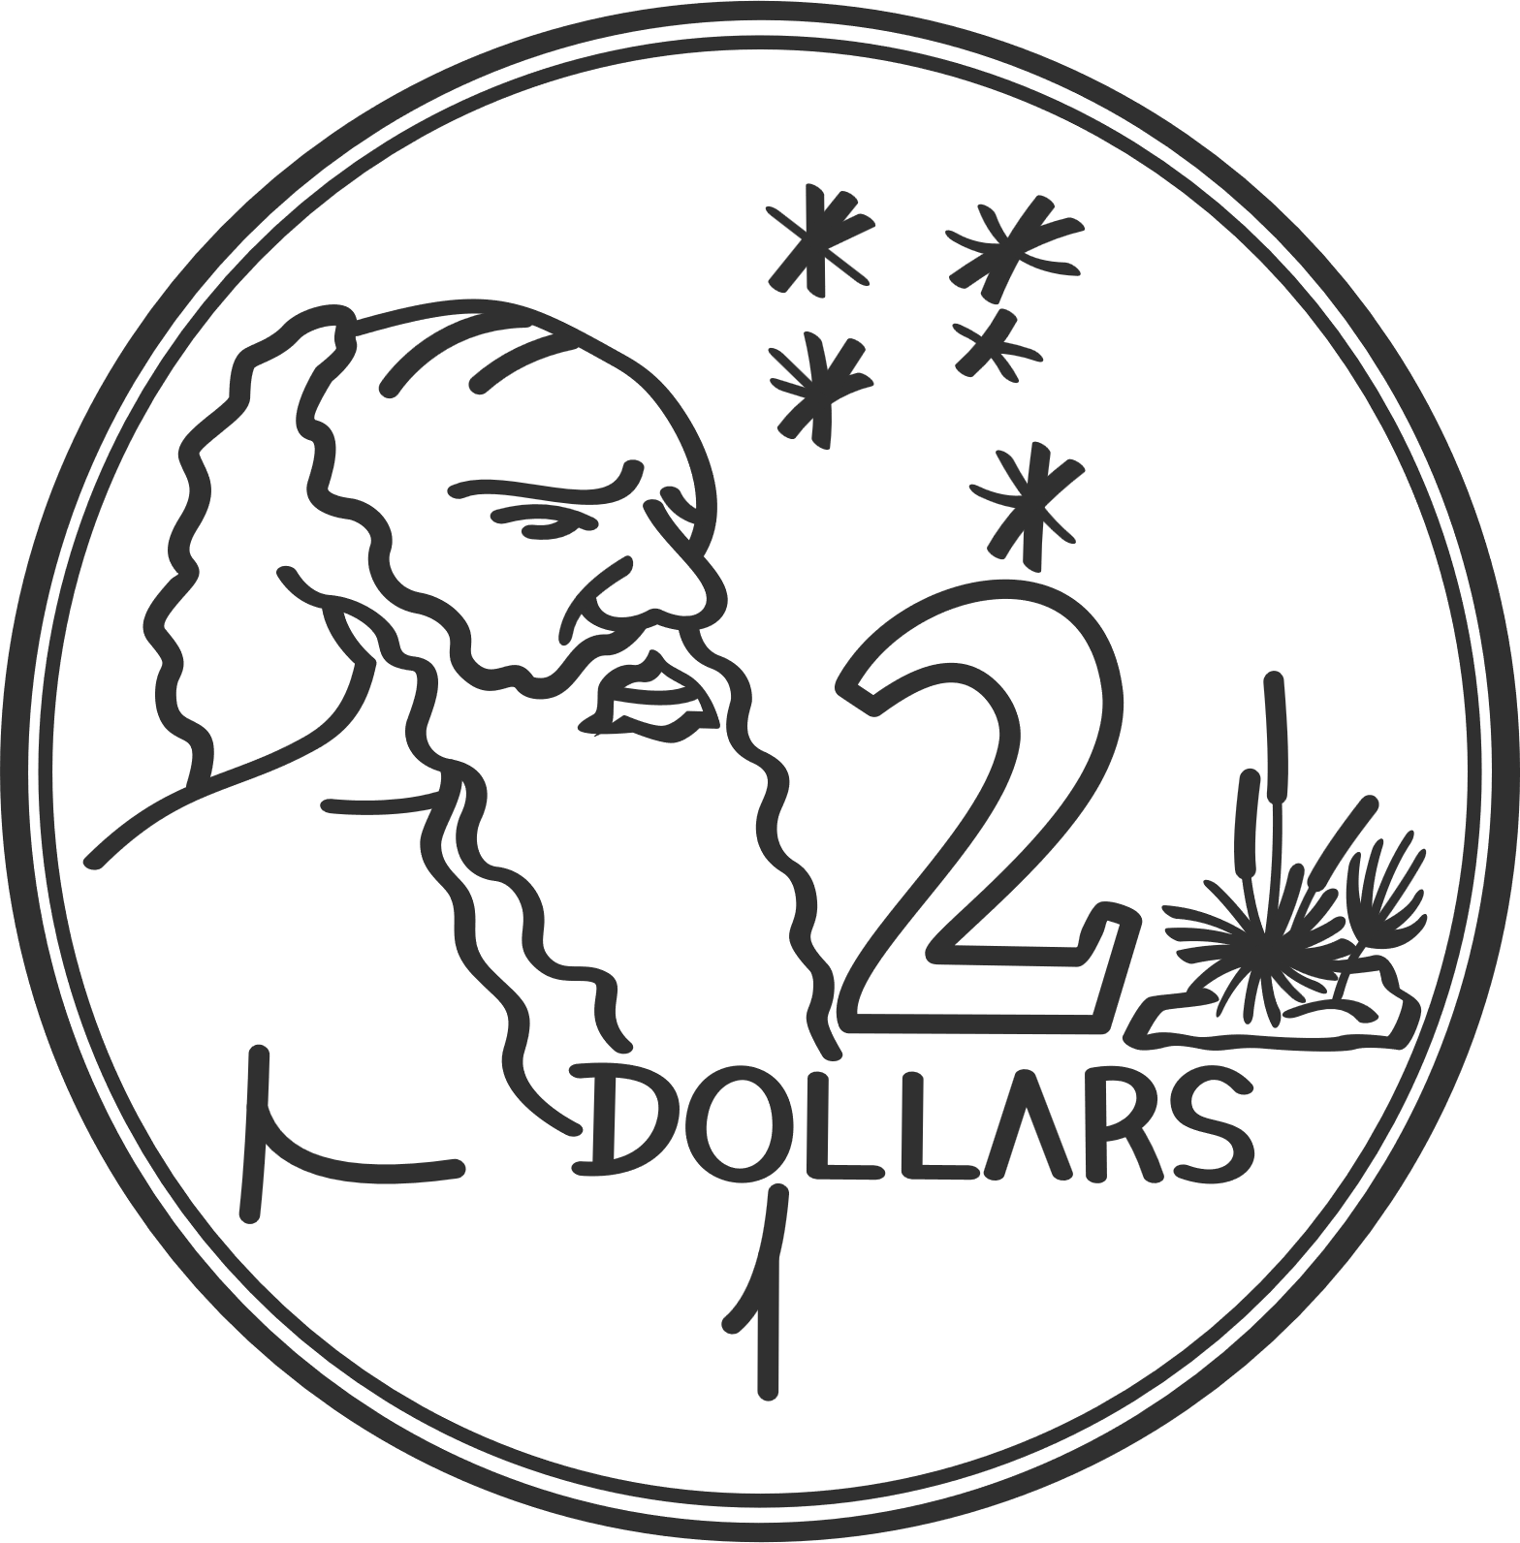





Activity 5 – equivalent money
Notes:
This is a developing number sense activity.
Number sense refers to a deep understanding of numbers, including their magnitude, relationships, and the effects of operations on them. It supports fluency and understanding, estimation, flexible thinking, and efficient problem-solving. Number sense activities 1–4 ‘activate’ prior number knowledge and support the learning of new content in the unit. Number sense activities 5–8 ‘loop’ back and provide opportunity for spaced practice with concepts and procedures covered in previous units.
Syllabus focus area:
Additive relations A
Equivalent money
Note: plastic coins and notes can be used during this activity. Current Australian coins in circulation can be identified at Royal Australian Mint. Current Australian notes in circulation can be identified at Reserve Bank of Australia.
Ask students: How many ways can one dollar be made using different coins?
Using the coins on the screens, model creating 2 different combinations of one dollar (duplicate coins as needed). For example, two 50 cent coins and ten 10 cent coins.
Using plastic money, and working in pairs or small groups, students take turns creating other different combinations of coins that are equivalent to one dollar, finding as many combinations as possible.
Ask students: How many other combinations did you find?
Students then create different combinations of coins that are equivalent to 2 dollars, finding as many combinations as possible.
Select students to answer the question:
What combinations of coins did you find that were equivalent to 2 dollars?

Slide 39
Review of learning 6

Slide 40
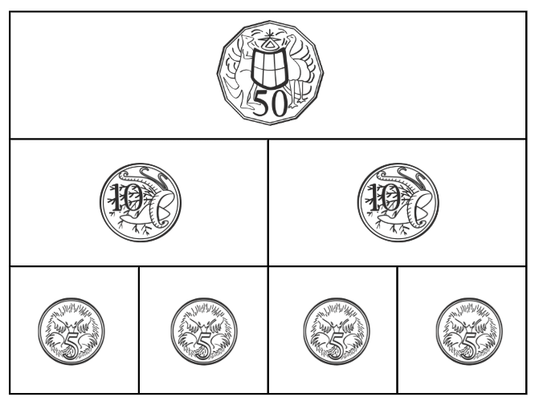
True or false (3)(1)
This money wall accurately shows equivalent coin denominations.
True | False
Notes:
The question on this slide connects to the content being explored in the developing number sense activity (Activity 6)
Syllabus focus area:
Additive relations A

Slide 41
Short response (21)
Is 6-tenths closer to 1 or 2?
Communicate your reasoning.
Notes:
Short response questions provide brisk paced questions focussing on review of current and previous content to support spaced and interleaved practice.
Syllabus focus area:
Representing numbers using place value B: Decimals

Slide 42
Short response (22)
During a book drive, the school collected 840 books in the first week and 675 books in the second week. They donated 950 books to a local library.
How many books does the school have left?
Notes:
Short response questions provide brisk paced questions focussing on review of current and previous content to support spaced and interleaved practice.
Syllabus focus area:
Additive relations B

Slide 43
Short response (23)
A chocolate bar weighs 250 grams. What fraction of a kilogram is this?
Explain your answer.
Notes:
Short response questions provide brisk paced questions focussing on review of current and previous content to support spaced and interleaved practice.
Syllabus focus area:
Non spatial measure B: Mass

Slide 44
Short response (24)
Draw a rectangular prism and label the faces, vertices and edges.
Notes:
Short response questions provide brisk paced questions focussing on review of current and previous content to support spaced and interleaved practice.
Syllabus focus area:
Three-dimensional spatial structure B: 3DS Objects

Slide 45
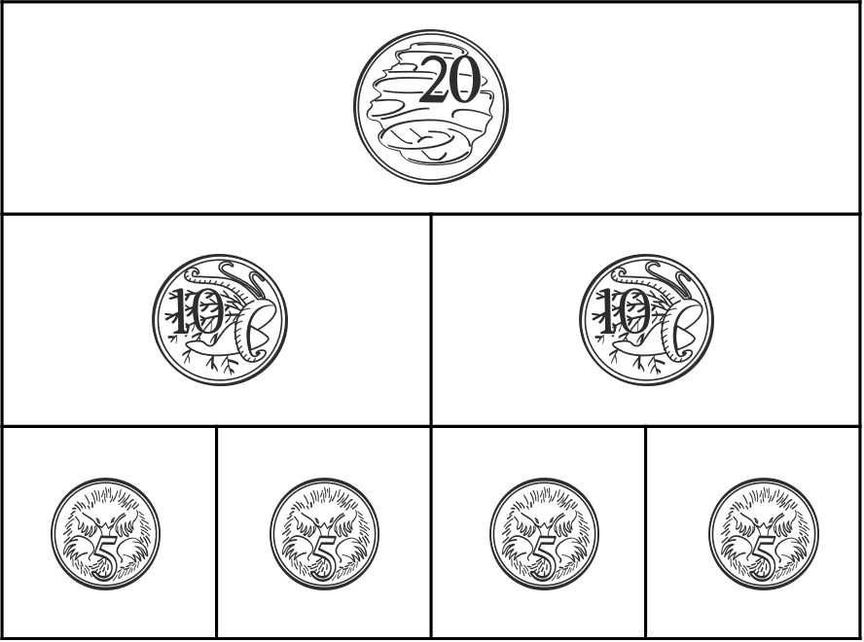
Activity 6 – equivalent amounts of money?
Notes:
This is a developing number sense activity.
Number sense refers to a deep understanding of numbers, including their magnitude, relationships, and the effects of operations on them. It supports fluency and understanding, estimation, flexible thinking, and efficient problem-solving. Number sense activities 1–4 ‘activate’ prior number knowledge and support the learning of new content in the unit. Number sense activities 5–8 ‘loop’ back and provide opportunity for spaced practice with concepts and procedures covered in previous units.
Syllabus focus area:
Additive relations A
Equivalent amounts of money
This activity is an adaptation of Classroom talk: Money Wall moments from the Mathematics Hub by the Commonwealth of Australia.
Display Resource 21 - completed money wall (this resource corresponds to Resource 21 – completed money wall in Stage 2, Year B Unit 36).
Explain to students that each row in this grid is equal to the 20 cents in the top row.
Note: Ensure students recognise and understand that each row in the money wall is made up of double the parts of the row above. Make connections to a fraction wall that shows one whole, 2-halves, and 4-quarters. Identify that every row is equivalent; they have the same value.
Provide pairs of students with Resource 22 – money wall and four 5 cent coins, eight 10 cent coins, eight 20 cent coins, four 50 cent coins, two $1 coins and one $2 coin.
Note: if no plastic Australian coins are available, use Resource 23 – Australian coins.
Students create money walls with 80 cents, $1.40 and $2.80 in the top row and add the total for each money wall.
Select students to answer:
What strategies did you use to find the different combinations?
How do you know if all equivalent combinations have been made?

Slide 46
Review of learning 7

Slide 47
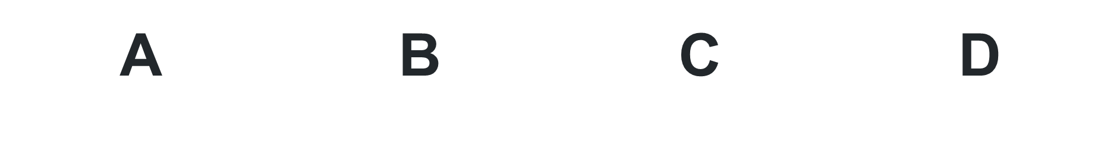
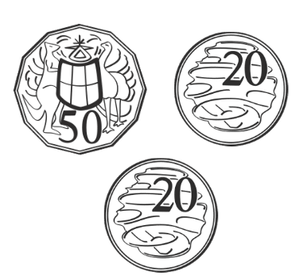
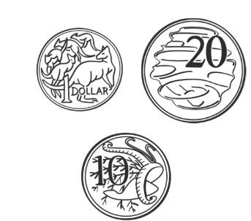
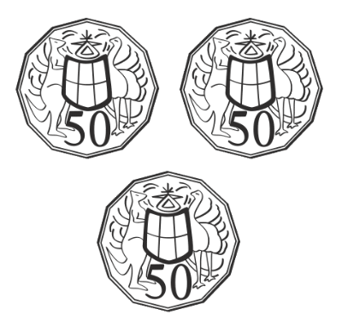
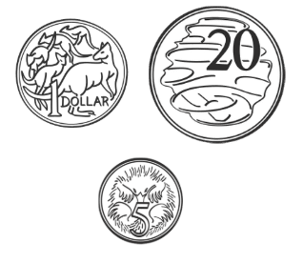
Multiple choice (4) (1)
If I had a $5 note and I purchased a sandwich for $3.75, what is the correct amount of change I would be given?
Notes:
This question connects to the content in the developing number sense activity (Activity 7)
Syllabus focus area:
Additive relations A

Slide 48
Short response (25)
How many ways can you represent 0.5 as a fraction?
Notes:
Short response questions provide brisk paced questions focussing on review of current and previous content to support spaced and interleaved practice.
Syllabus focus area:
Representing numbers using place value B: Decimals

Slide 49
Short response (26)
Lucy has $45 saved up for her birthday. She wants to buy a new book that costs $18 and a toy that costs $22. If she buys both, how much money will she have left?
Notes:
Short response questions provide brisk paced questions focussing on review of current and previous content to support spaced and interleaved practice.
Syllabus focus area:
Additive relations B

Slide 50
Short response (27)
A watermelon weighs over 1 kilogram.
How might you record a mass using a combination of kilograms and grams?
Notes:
Short response questions provide brisk paced questions focussing on review of current and previous content to support spaced and interleaved practice.
Syllabus focus area:
Non spatial measure B: Mass

Slide 51
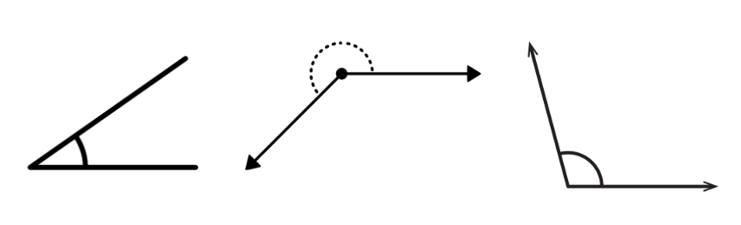
Short response (28)
Describe these angles as less than, equal to, about the same as or greater than a right angle.
Notes:
Short response questions provide brisk paced questions focussing on review of current and previous content to support spaced and interleaved practice.
Syllabus focus area:
Geometric measure B: Angles

Slide 52
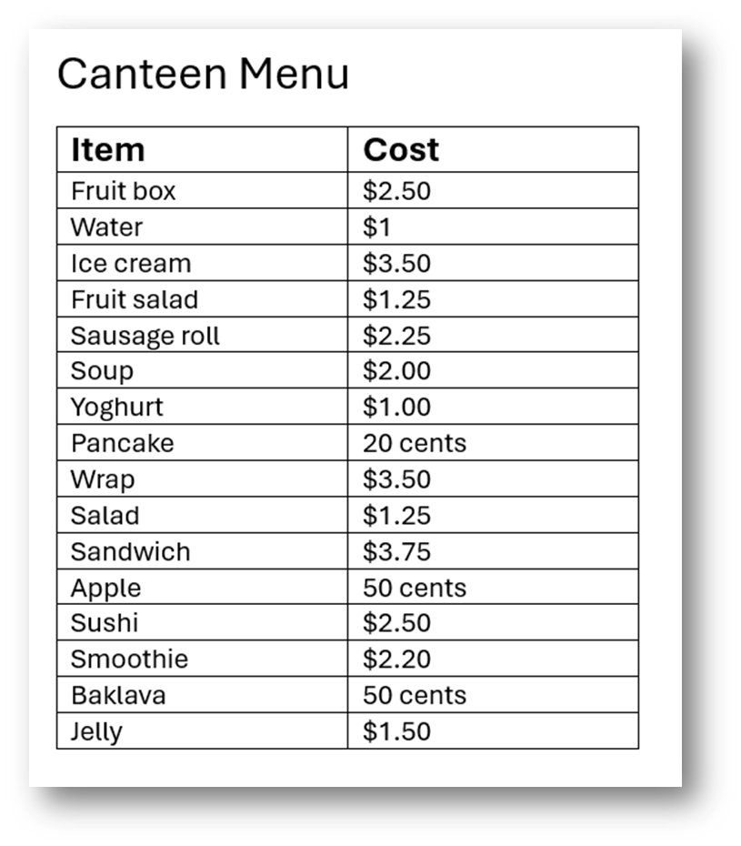
Activity 7 – calculations with money
Notes:
This is a developing number sense activity.
Number sense refers to a deep understanding of numbers, including their magnitude, relationships, and the effects of operations on them. It supports fluency and understanding, estimation, flexible thinking, and efficient problem-solving. Number sense activities 1–4 ‘activate’ prior number knowledge and support the learning of new content in the unit. Number sense activities 5–8 ‘loop’ back and provide opportunity for spaced practice with concepts and procedures covered in previous units.
Syllabus focus area:
Additive relations A
Calculations with money
Display Resource 24 – canteen price list (this resource corresponds to Resource 24 – canteen price list in Stage 2, Year B Unit 36).
Use a think aloud: I have $1 to buy something from the canteen. I am going to buy an apple. What else can I buy with my change?
Use a think aloud: I know that half of one dollar is 50 cents, so I can buy 2 items that are fifty cents each. I can buy my apple and baklava. I can also see that I could buy some pancakes instead. I know that if I have 50 cents then I can buy 2 pancakes, and I will get some change.
Pose the question: If you bought an ice cream, an apple, a juice and a sandwich, how much change would you receive from $12?
Ask students to work with a partner to solve the question in their books (or on whiteboards)
Select students to share which strategy was used to determine the answer and why they found this to be the most efficient.

Slide 53
Review of learning 8

Slide 54
True or false (4)(1)
Leon and Tobi were counting their change.
Tobi said, “I had $5 and purchased an ice-block for $3.75. I have $1.75 left.”
Leon shook his head and said, “That can’t be right!”
Is Tobi's statement true or false?
True | False
Notes:
The question on this slide connects to the content being explored in the developing number sense activity (Activity 8)
Syllabus focus area:
Multiplicative relations A

Slide 55
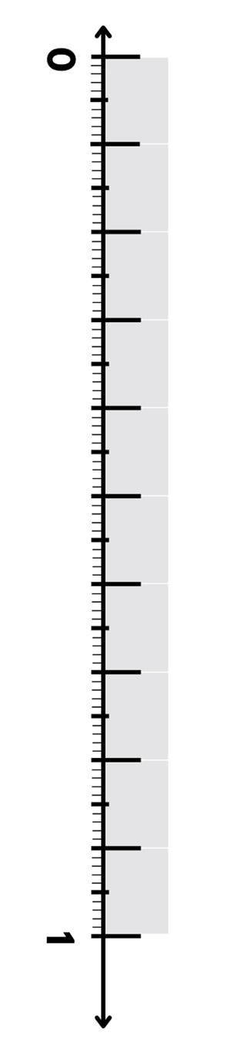
Short response (29)
Describe where 0.75 would be placed on the number line.
Explain your reasoning.
Notes:
Short response questions provide brisk paced questions focussing on review of current and previous content to support spaced and interleaved practice.
Syllabus focus area:
Representing numbers using place value B: Decimals

Slide 56
Short response (30)
Tom has a budget of $67 to spend on supplies for a school project. He buys a set of markers for $15.75 and a pack of paper for $10.23.
How much money does Tom have left for other supplies?
Notes:
Short response questions provide brisk paced questions focussing on review of current and previous content to support spaced and interleaved practice.
Syllabus focus area:
Additive relations B

Slide 57
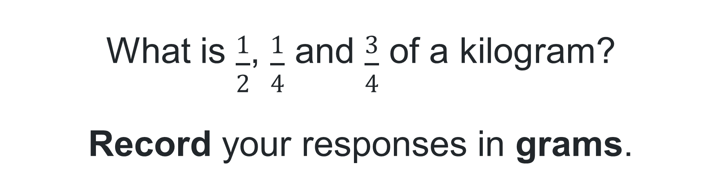
Short response (31)
What is $\frac{1}{2}$, $\frac{1}{4}$ and $\frac{3}{4}$ of a kilogram?
Record your responses in grams.
Notes:
Short response questions provide brisk paced questions focussing on review of current and previous content to support spaced and interleaved practice.
Syllabus focus area:
Non spatial measure B: Mass

Slide 58
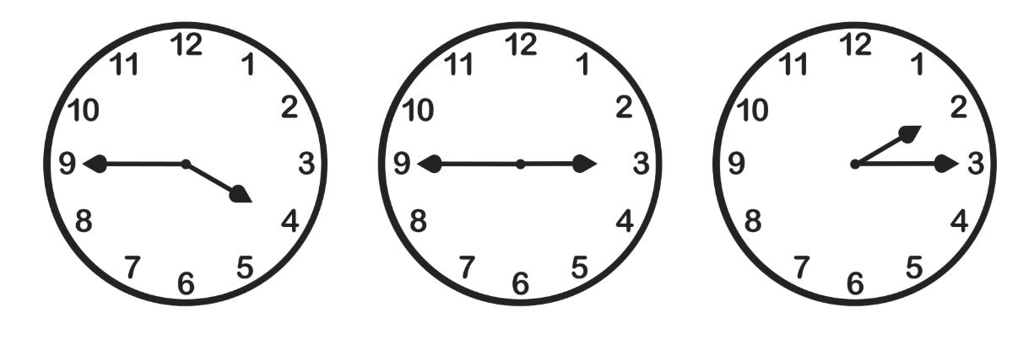
Short response (32)
Record these times using digital notation.
Notes:
Short response questions provide brisk paced questions focussing on review of current and previous content to support spaced and interleaved practice.
Syllabus focus area:
Non spatial measure B: Time

Slide 59
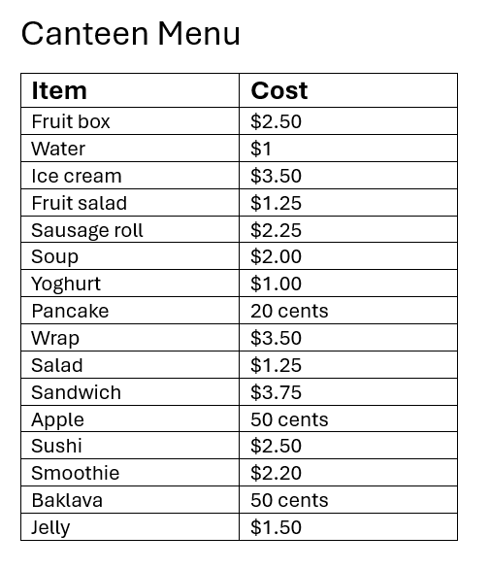
Activity 8 – finding change
Notes:
This is a developing number sense activity.
Number sense refers to a deep understanding of numbers, including their magnitude, relationships, and the effects of operations on them. It supports fluency and understanding, estimation, flexible thinking, and efficient problem-solving. Number sense activities 1–4 ‘activate’ prior number knowledge and support the learning of new content in the unit. Number sense activities 5–8 ‘loop’ back and provide opportunity for spaced practice with concepts and procedures covered in previous units.
Syllabus focus area:
Additive relations A
Finding change
Display Resource 24 – canteen price list (this resource corresponds to Resource 24 – canteen price list in Stage 2, Year B Unit 36).
Pose the question: If you received $3.50 change from $15, what could you have bought?
Ask students to work with a partner to solve the question in their books (or on whiteboards).
Select students to share which strategy was used to determine the answer and why they found this to be the most efficient. Repeat with another student.

Slide 60
Double Venn diagram
Object 1
Object 2
Features similar to both objects
Features of object 1
Features of object 2

Slide 61
Frayer
Definition
Facts/Characteristics
Word, term, concept
Examples
Non-examples

Slide 62
Spider map
Idea
Subject

Slide 63
Cline
Concept 1
Concept 2
Word
Word
Word
Word
Word
Word
Word
Word
Word
Word
Word

Slide 64

Compare and contrast
Notes:
Use the arrows to navigate between related activities.
Hyperlink each arrow to compare between related slides.

Slide 65
Multiple choice (1)
A
B
C
D
Notes:
This question connects to the content in the developing number sense activity (Activity 1)
This question can:
support spaced and interleaved practice
help identify and address common misconceptions
support active recall and immediate feedback
support whole class participation
identify areas requiring reteach
Teachers are encouraged to adapt and contextualise for their contexts.

Slide 66
Multiple choice (2)
A
B
C
D
Notes:
This question connects to the content in the developing number sense activity (Activity 1)
Syllabus focus area:
Multiplicative relations A
This question can:
support spaced and interleaved practice
help identify and address common misconceptions
support active recall and immediate feedback
support whole class participation
identify areas requiring reteach
Teachers are encouraged to adapt and contextualise for their contexts.

Slide 67
References
This presentation contains NSW Curriculum and syllabus content. The NSW Curriculum is developed by the NSW Education Standards Authority. This content is prepared by NESA for and on behalf of the Crown in the right of the State of New South Wales. The material is protected by Crown copyright.
Please refer to the NESA Copyright Disclaimer for more information https://educationstandards.nsw.edu.au/wps/portal/nesa/mini-footer/copyright.
NESA holds the only official and up-to-date versions of the NSW Curriculum and syllabus documents. Please visit the NSW Education Standards Authority (NESA) website https://educationstandards.nsw.edu.au/wps/portal/nesa/home and the NSW Curriculum website https://curriculum.nsw.edu.au.
Mathematics K-10 Syllabus © Syllabus NSW Education Standards Authority (NESA) for and on behalf of the Crown in right of the State of New South Wales, 2022.​
Amplify Education (n.d.) Polypad, Amplify website, accessed 29 February 2024.​
Commonwealth of Australia (2020) Classroom talk: Money Wall moments [PDF 275 KB], Mathematics Hub, accessed 29 February 2024.​
Commonwealth of Australia (2023) Circulating coins, Australian Government (Royal Australian Mint) website, accessed 29 February 2024.​
Epstein M (5 November 2020, updated 5 June 2021) ‘Exploring the Edges of Mathematical Ideas’, Mathematics Education, accessed 29 February 2024.​
Pierce R (2023) Make the Amount, Math Is Fun website, accessed 29 February 2024.​
Reserve Bank of Australia (2012–2024) Banknotes in Circulation, Reserve Bank of Australia website, accessed 29 February 2024.

Slide 68
References (2)
This presentation contains NSW Curriculum and syllabus content. The NSW Curriculum is developed by the NSW Education Standards Authority. This content is prepared by NESA for and on behalf of the Crown in the right of the State of New South Wales. The material is protected by Crown copyright.
Please refer to the NESA Copyright Disclaimer for more information https://educationstandards.nsw.edu.au/wps/portal/nesa/mini-footer/copyright.
NESA holds the only official and up-to-date versions of the NSW Curriculum and syllabus documents. Please visit the NSW Education Standards Authority (NESA) website https://educationstandards.nsw.edu.au/wps/portal/nesa/home and the NSW Curriculum website https://curriculum.nsw.edu.au.
Siemon D (2002) Partitioning – The missing link in building fraction knowledge and confidence [PDF 103 KB], RMIT University, Victoria, Australia.​
Siemon D, Warren E, Beswick K, Faragher R, Miller J, Horne M, Jazby D, Breed M, Clark J and Brady K (2021) Teaching Mathematics: Foundations to Middle Years, 3rd edn, Oxford University Press Australia and New Zealand.​
The Maths Learning Centre (2005–2024) Fractions, Math Learning Centre website, accessed 29 February 2024.​
Tribal Group PLC (n.d.) ‘Unit Fractions’, Year 3 curriculum map, National Centre for Excellence in the Teaching of Mathematics (NCETM) website, accessed 29 February 2024.

Slide 69
Copyright
© State of New South Wales (Department of Education), 2025
The copyright material published in this resource is subject to the Copyright Act 1968 (Cth) and is owned by the NSW Department of Education or, where indicated, by a party other than the NSW Department of Education (third-party material).
Copyright material available in this resource and owned by the NSW Department of Education is licensed under a Creative Commons Attribution 4.0 International (CC BY 4.0) license.
This license allows you to share and adapt the material for any purpose, even commercially.
Attribution should be given to © State of New South Wales (Department of Education), 2025.
Material in this resource not available under a Creative Commons license:
the NSW Department of Education logo, other logos and trademark-protected material
Material owned by a third party that has been reproduced with permission. You will need to obtain permission from the third party to reuse its material.
Links to third-party material and websites
Please note that the provided (reading/viewing material/list/links/texts) are a suggestion only and implies no endorsement, by the New South Wales Department of Education, of any author, publisher, or book title. School principals and teachers are best placed to assess the suitability of resources that would complement the curriculum and reflect the needs and interests of their students.
If you use the links provided in this document to access a third party’s website, you acknowledge that the terms of use, including licence terms set out on the third-party’s website apply to the use which may be made of the materials on that third-party website or where permitted by the Copyright Act 1968 (Cth). The department accepts no responsibility for content on third-party websites.

